Slide 1
Ai- agentic hiring intelligence
Project Presentation
Submitted By: Avanaganti Poojitha
Department: Computer Science Engineering
College: Sphoorthy Engineering College
Technology Stack: MERN Stack with Artificial Intelligence
Academic Year: 2025 – 2026

Slide 2
ABSTRACT
The AI Agentic Hiring Intelligence & Recruitment Automation System is an AI-based recruitment platform that automates job data collection, hiring analysis, and recruitment management. The system collects job postings from multiple platforms and uses AI to extract skills, experience, salary details, and hiring trends.
The project includes features like lead scoring, resume analysis, company intelligence, real-time dashboards, role-based access control, OTP email verification, and automated recruitment analytics for recruiters and candidates. It is developed using React.js, Node.js, MongoDB, Redis, Playwright, and Gemini AI to improve hiring efficiency, enhance recruitment accuracy, and reduce manual recruitment effort.

Slide 3
INTRODUCTION
The AI Agentic Hiring Intelligence & Recruitment Automation System is a smart AI-powered platform developed to simplify and automate the recruitment process. The system collects job data from multiple online platforms and analyzes it using Artificial Intelligence to generate meaningful hiring insights.
The platform helps recruiters identify required skills, hiring trends, company growth patterns, and candidate suitability through intelligent analytics and real-time dashboards. It also provides features such as resume analysis, lead scoring, role-based access control, and automated recruitment management.
The project is developed using modern technologies like React.js, Node.js, Express.js, MongoDB, Redis, Playwright, and Gemini AI. The main objective of the system is to improve hiring efficiency, reduce manual effort, and provide accurate recruitment intelligence through AI-driven automation.

Slide 4
LITERATURE REVIEW EXTENSION
Traditional recruitment systems require significant manual effort for job searching, candidate screening, and hiring analysis. Existing recruitment platforms provide limited automation and lack intelligent insights for understanding hiring trends and skill demands.
Recent advancements in Artificial Intelligence, Machine Learning, and web scraping technologies have improved recruitment processes through automated job analysis, skill extraction, and predictive analytics. Modern systems focus on automation, real-time analytics, and intelligent decision-making to improve recruitment efficiency.
The proposed system combines AI, autonomous scraping agents, recruitment analytics, and real-time dashboards into a single intelligent platform to automate hiring processes and provide better recruitment insights.

Slide 5
PROBLEM STATEMENT
Traditional recruitment systems involve manual job collection, candidate screening, and hiring analysis, which consume significant time and effort. Existing platforms often lack intelligent automation, real-time hiring insights, and efficient recruitment analytics, making it difficult for recruiters to identify suitable candidates and track market trends effectively.
There is a need for a smart recruitment system that can automatically collect job data, analyze hiring requirements using Artificial Intelligence, and provide real-time insights such as skill demand, hiring trends, and company lead scoring. The proposed system aims to solve these challenges by providing an AI-powered recruitment automation platform that improves hiring efficiency, reduces manual work, and supports better recruitment decision-making.

Slide 6
TECHNOLOGIES USED
Frontend: React.js, Vite, Tailwind CSS, Redux Toolkit
Backend: Node.js, Express.js
Database: MongoDB, Mongoose
AI Technologies: Gemini AI, Groq API
Web Scraping: Playwright, Cheerio
Authentication & Security: JWT, Bcrypt, OTP Verification
Background Processing: Redis, BullMQ
Data Visualization: Recharts, Framer Motion
Version Control: Git & GitHub

Slide 7
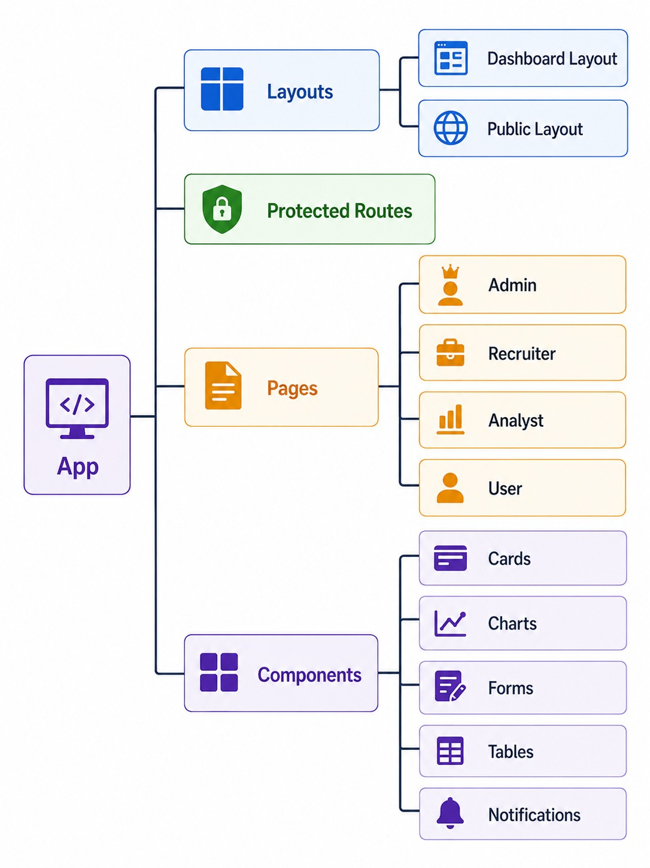
DESIGN

Slide 8
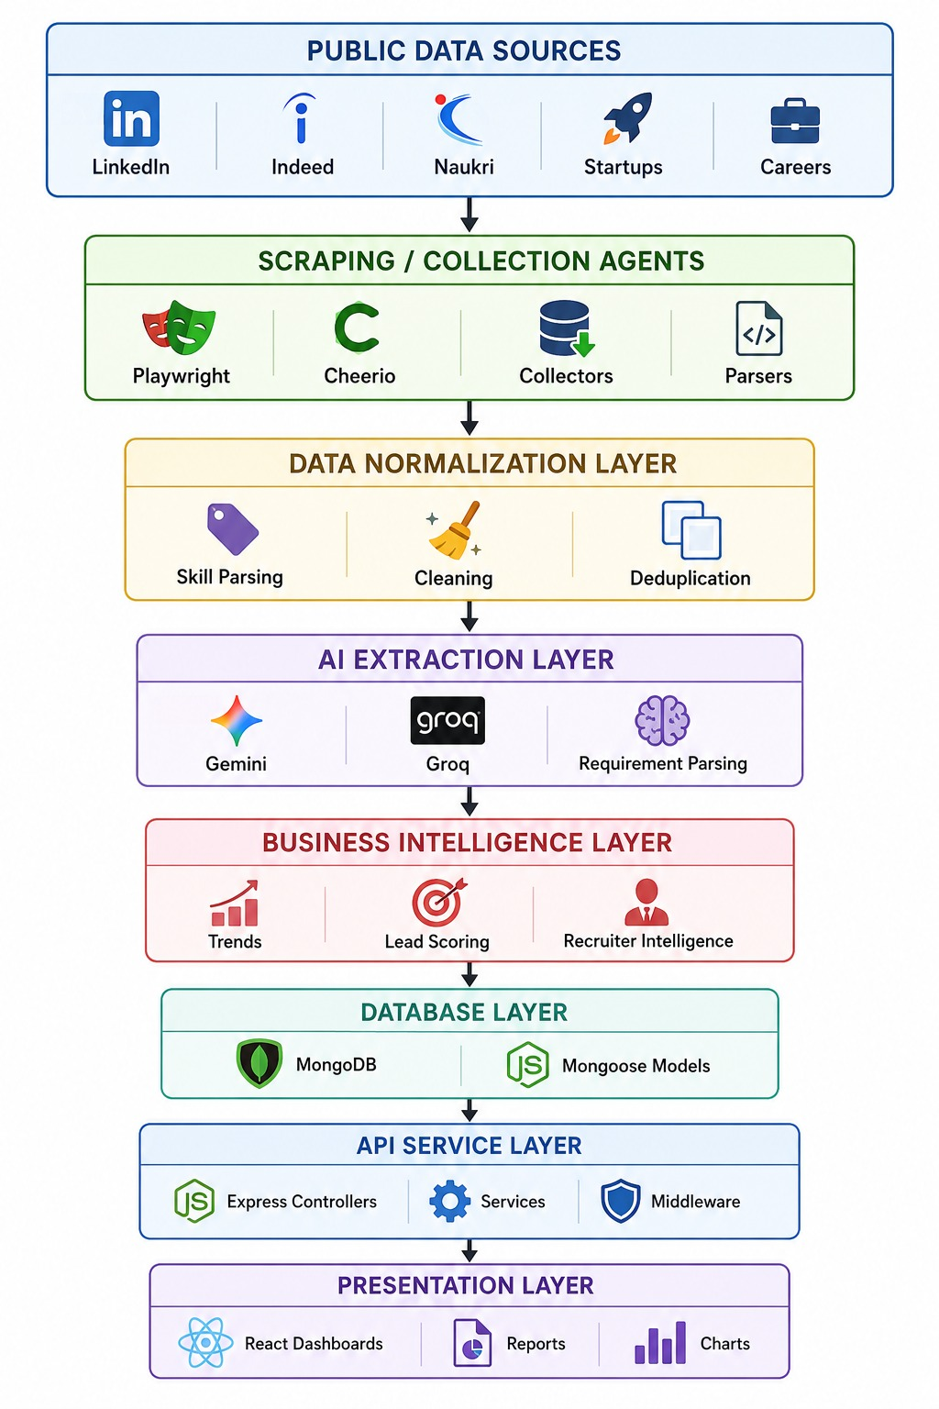
DESIGN

Slide 9
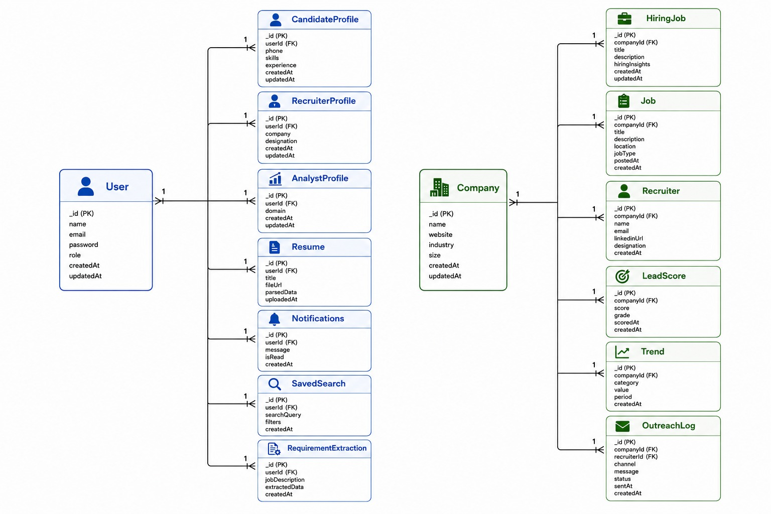
System Architecture Design

Slide 10
REFERENCES
React.js Documentation – https://react.dev
Node.js Documentation – https://nodejs.org
MongoDB Documentation – https://www.mongodb.com/docs
Express.js Documentation – https://expressjs.com
Playwright Documentation – https://playwright.dev
Tailwind CSS Documentation – https://tailwindcss.com
Google Gemini AI Documentation – https://ai.google.dev
Redis Documentation – https://redis.io/docs
BullMQ Documentation – https://docs.bullmq.io
Research Papers on AI-based Recruitment and Hiring Analytics

Slide 11


